Slide 1

7th Grade Math
Unit 3, Lesson 3 Multiplying Rational Numbers Volume 1, pg. 96

Slide 2


Benchmark
MA.7.NSO.2.2
Add, subtract, multiply, and divide rational numbers with procedural fluency.
volume 1, pg. 96

Slide 3
Integrated Mathematical Thinking and Reasoning Standards
MA.K12.MTR.1.1 Actively participate in effortful learning both individually and collectively.
MA.K12.MTR.2.1 Demonstrate understanding by representing problems in multiple ways.
MA.K12.MTR.3.1 Complete tasks with mathematical fluency.
MA.K12.MTR.4.1 Engage in discussions that reflect on the mathematical thinking of self and others.
MA.K12.MTR.5.1 Use patterns and structure to help understand and connect mathematical concepts.
volume 1, pg. 96

Slide 4

Learning Target
I can fluently multiply rational numbers.
volume 1, pg. 96

Slide 5

Warm-Up
volume 1, pg. 97

Slide 6
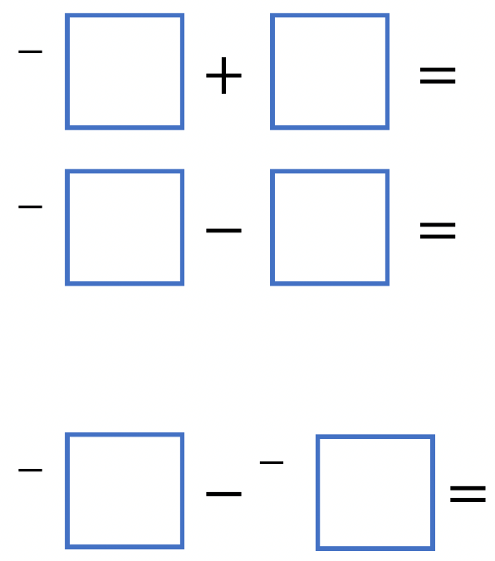
3.3.1 Warm-Up: Bell Work
Using the digits $1$ to $6$ at most one time each, fill in the boxes so that the top two equations are equal, and the bottom equation has the greatest value.
volume 1, pg. 97
Notes:
Video Link: https://algebranation.wistia.com/medias/fi4fidi5y8

Slide 7

Collaboration
volume 1, pg. 97

Slide 8

3.3.2 Collaboration: Signed Number Rules
Fill in the blank with the words positive or negative to describe the rules for multiplying integers.
The product of two positive integers is a ____________ integer.
The product of two negative integers is a ___________ integer.
The product of a negative integer and a positive integer is a ____________ integer.
volume 1, pg. 97

Slide 9
Discuss with your partner whether you think the same rules apply to rational numbers. Write a summary of your reasoning.
volume 1, pg. 97

Slide 10
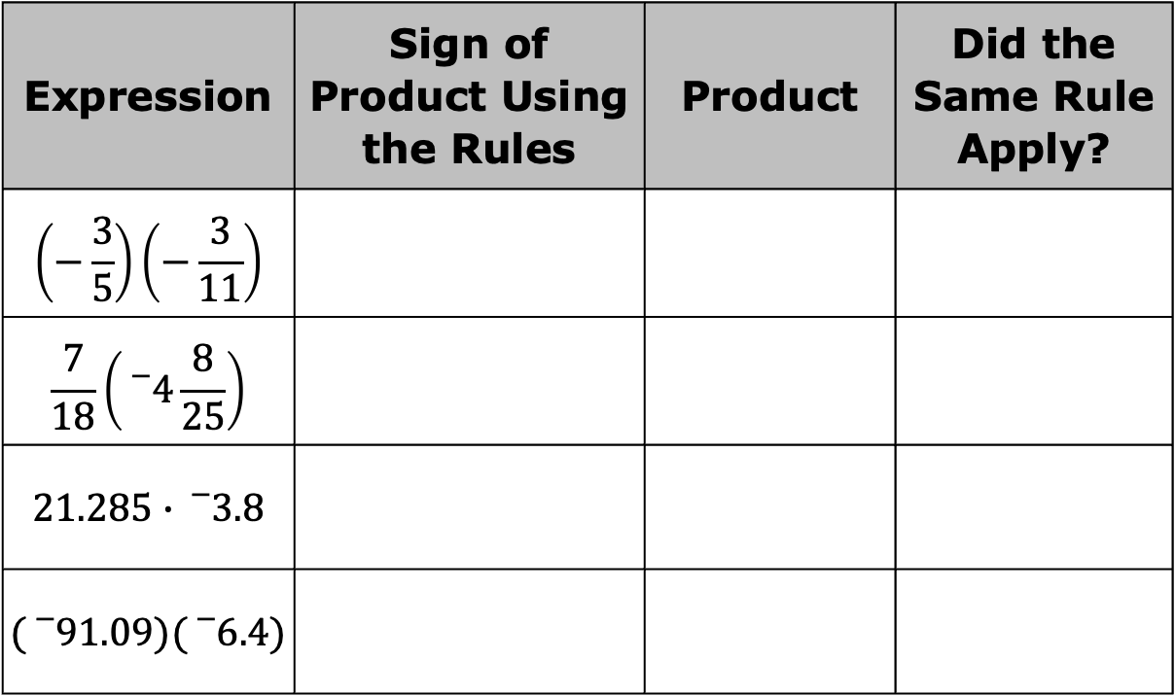
Complete the table. Use a calculator to find the product of each expression to verify if the same rules for signs apply when multiplying rational numbers.
Expression | Sign of Product Using the Rules | Product | Did the Same Rule Apply?
$$\left(−\frac{3}{5}\right)\left(−\frac{3}{11}\right)$$
$$\frac{7}{18}\left({}_{}^{−}{4\frac{8}{25}}\right)$$
$$21.285∙{}_{}^{−}{3.8}$$
$$({}_{}^{−}{91.09)}({}_{}^{−}{6.4})$$
volume 1, pg. 98

Slide 11
Complete the sentence.
The rules for multiplying rational numbers are the integer rules for multiplication.
the same as
different from
volume 1, pg. 98

Slide 12

Guided Practice
volume 1, pg. 98

Slide 13

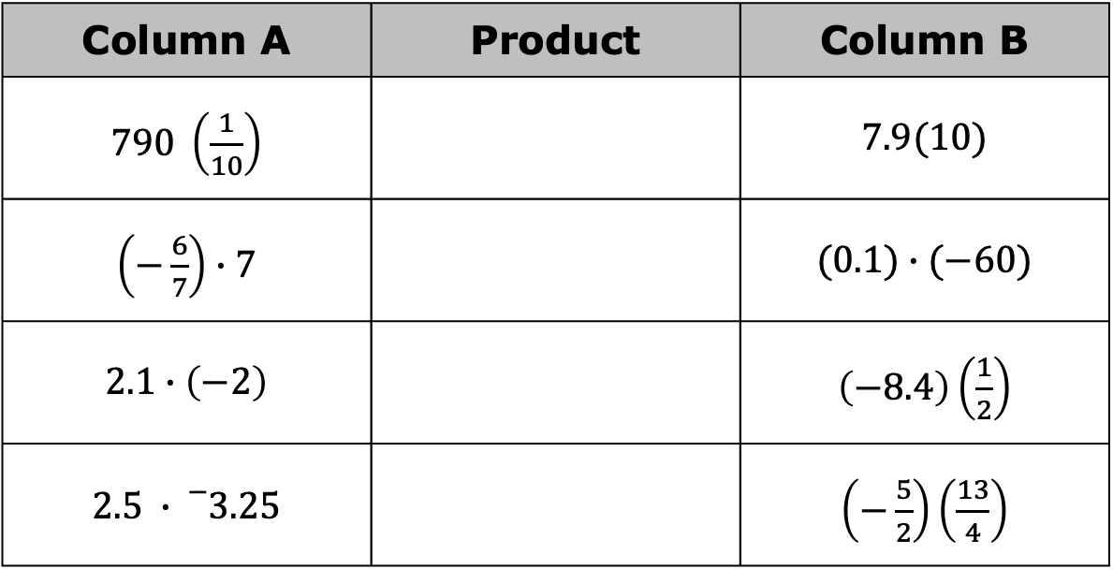
3.3.3 Guided Practice: Applying Signed Number Rules to Rational Numbers
With your partner, decide who will be Partner A and who will be Partner B. Then, find the product of the expression in the column that matches your letter.
Column A | Product | Column B
$790 \left(\frac{1}{10}\right)$ |  | $$7.9(10)$$
$\left(−\frac{6}{7}\right)∙7$ |  | $$(0.1)∙(−60)$$
$$2.1∙\left(−2\right)$$ |  | $\left(−8.4\right)\left(\frac{1}{2}\right)$
$$2.5 ∙{}_{}^{−}{3.25}$$ |  | $\left(−\frac{5}{2}\right)\left(\frac{13}{4}\right)$
volume 1, pg. 98

Slide 14
The expressions in each row have the same product. Check your work with your partner and, if necessary, resolve any differences. Write the agreed-upon product in the center column.
volume 1, pg. 98

Slide 15
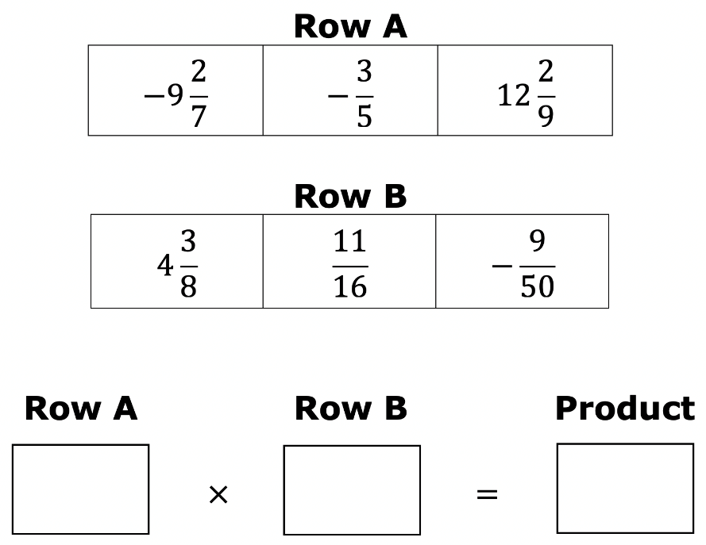
Choose a value from Row A and a value from Row B that, when multiplied, will result in a negative answer. Then, calculate the product.
volume 1, pg. 99

Slide 16

Wrap-Up
volume 1, pg. 99

Slide 17
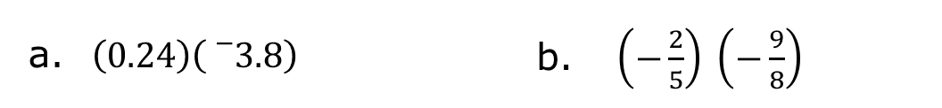
3.3.4 Wrap-Up: Ticket Out the Door
Find the product of each expression.
Fill in the blanks with the words positive or negative.
Two positive factors result in a _________ product.
Two negative factors result in a _________ product.
A positive factor and a negative factor result in a ___________ product.
$\left(0.24\right)\left({}_{}^{−}{3.8}\right)$ | $\left(−\frac{2}{5}\right) \left(−\frac{9}{8}\right)$
volume 1, pg. 99

